Slide 1


Grantees: Cohort 1 Extension
Presenting the
9 grant winners in the Caribbean Culture Fund
Cohort 1 Extension
—
March 2025

Slide 2
Countries and Themes
Eligible Countries:
Barbados
Dominican Republic
Haiti
Jamaica
Trinidad and Tobago
Themes:
Art for Social Change and Civic
Engagement
Caribbean Collaboration

Slide 3

Art for social change and civic engagement
Projects that challenge, critique, or transform the status quo, the dominant narratives, or the injustices in society. Sub-themes such as Caribbean identities, climate justice, may also be explored. Preference will be given to educational, experimental, and inclusive creations and productions, or training and/or transmission activities. Creativity means presenting quality original and/or experimental projects.
—
5 grantees receiving USD 10,000

Slide 4
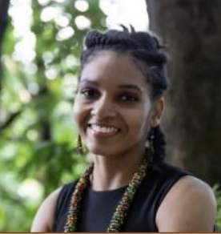
Le Programme d’Encadrement des Femmes Artistes
(Program Ankadre Atis Fanm)
The Support Program for Women Artists (Ankadre Atis Fanm) aims to improve the employability and recognition of women in the Haitian cultural sector. Over six months, it supports their production, promotes them and facilitates the transmission of their knowledge and skills, inspired by acts of gratitude. The project promotes inclusive practices, including work with girls and blind/ visually impaired groups, and shares a series of audio-visual and podcast materials online. Anchored in collective values and social engagement, the initiative strengthens women's voices in the arts and contributes to a living catalogue of artistic training rooted in dance, music, and community inclusion.
Amandine Saint Martin
Performing arts
Haiti

Slide 5
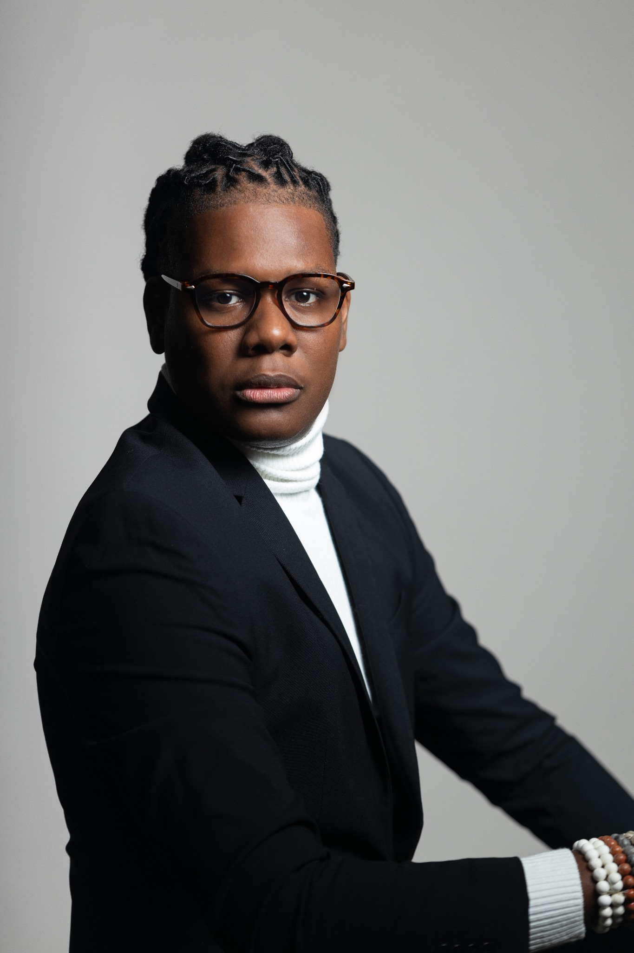
Beyond the Beach: An Immersive Community Experience
Beyond the Beach is a multidisciplinary launch event for an anthology that reimagines the blue economy through the lived experiences of Caribbean islanders. Featuring photography, spoken word, performance, and discussion, the Immersive Community Experience invites audiences to explore the cultural, ecological, and social dimensions of marine life. By highlighting coastal communities’ relationships with the sea, the project challenges extractive narratives and promotes human-centered, sustainable approaches to ocean stewardship. This debut event in Barbados marks the beginning of a broader series of book-centered gatherings, building a network for creative and political dialogue around coastal futures.
Clish Gittens
Literature and Publishing
Barbados

Slide 6
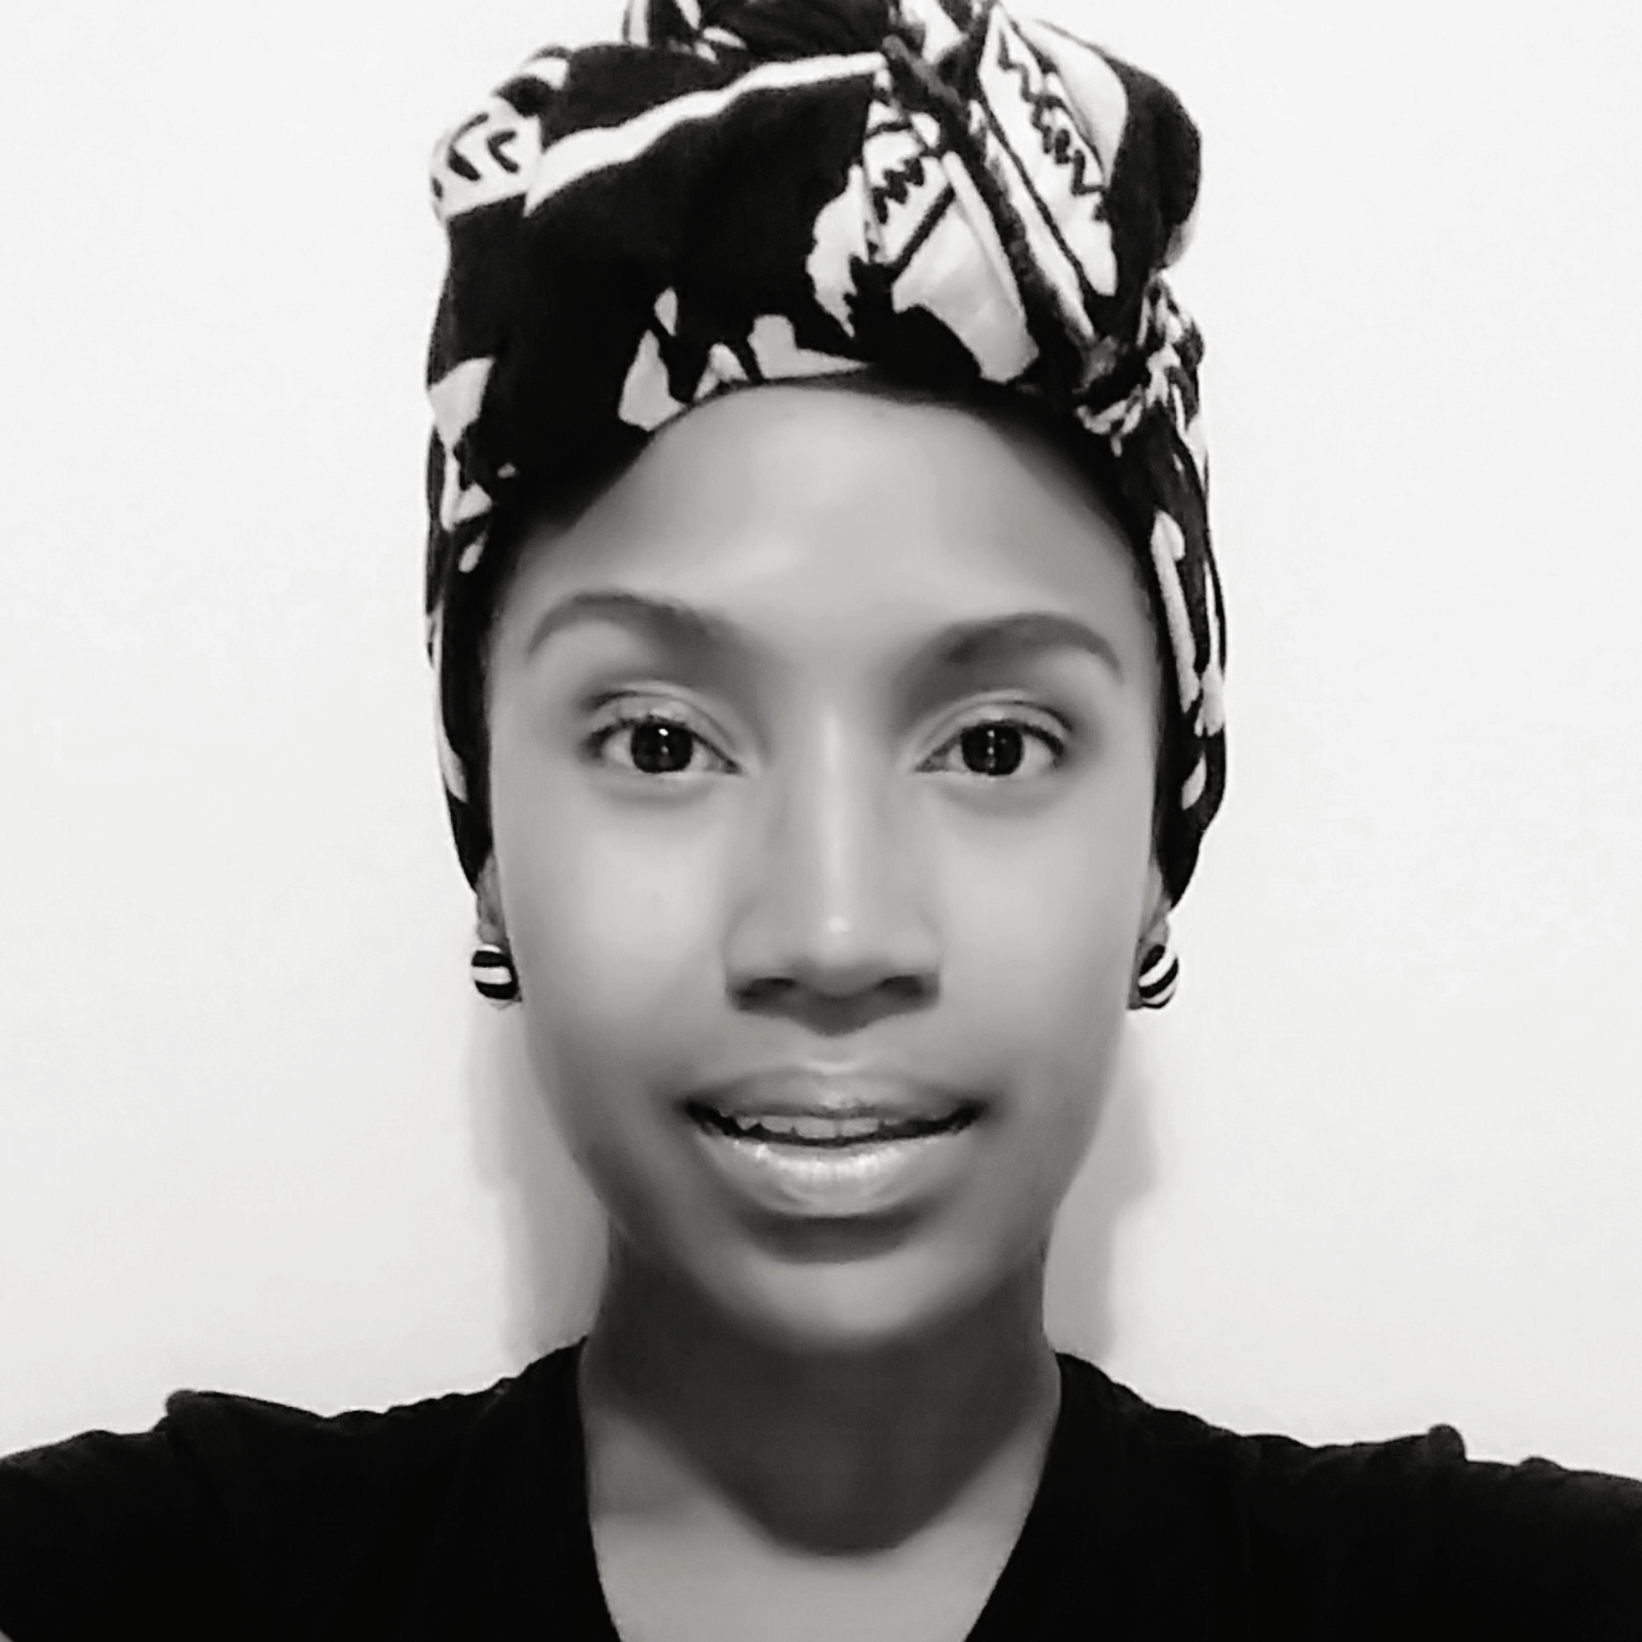
Listen Jamaica: A Sound Gallery Amplifying Jamaica’s Silenced Spaces
Listen Jamaica is a digital sound gallery that invites audiences to experience the island through its natural soundscapes. Its first virtual exhibit, The Riddim of Water, features original compositions created entirely from field recordings of Jamaica’s inland and coastal waters. Addressing urgent environmental concerns such as mining threats, beach access, and climate change, the project is guided by local cultural and environmental leaders. Through sound, interviews, and digital storytelling, Listen Jamaica creates a living archive that preserves endangered sonic environments while amplifying ecological awareness through artistic expression.
Dr. Isis Semaj-Hall
Music and sound recording
Jamaica

Slide 7
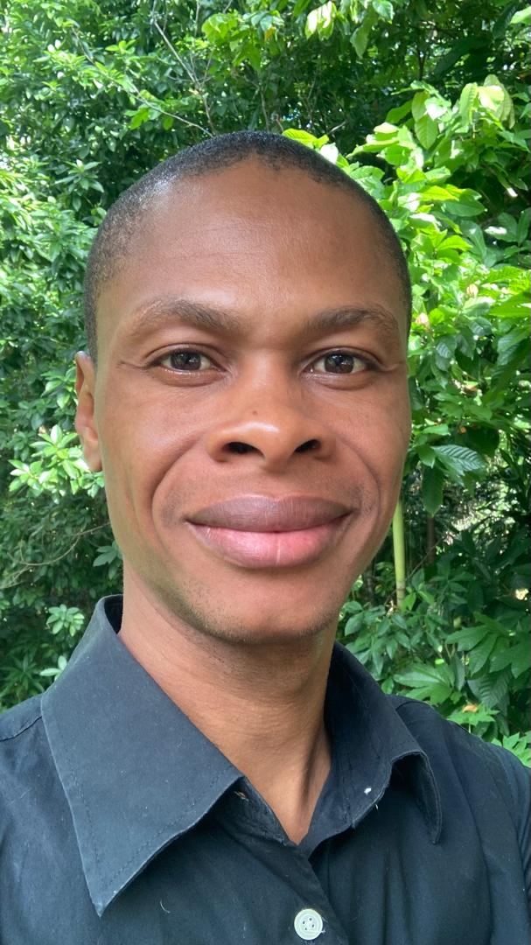
Mon Corps Non Tabou:
Using art and creativity with teenagers as a tool for expressing sexuality
Mon Corps Non Tabou aims to use creation as an educational and artistic tool to tackle the taboo subject of sexuality with adolescent girls. Expression and creative workshops supervised by professionals (psychologists and artists) will be organized in Port-au-Prince, Haiti, to enable young participants to express themselves on the subject of sexuality. Based on the exchanges and artistic productions of the workshops, a prototype book will be created, as well as various communication media on the subject of female sexuality, distributed online to Haitian youth, their families and entourage.
Louvenson Saint Juste
Literature and Publishing
Haiti

Slide 8
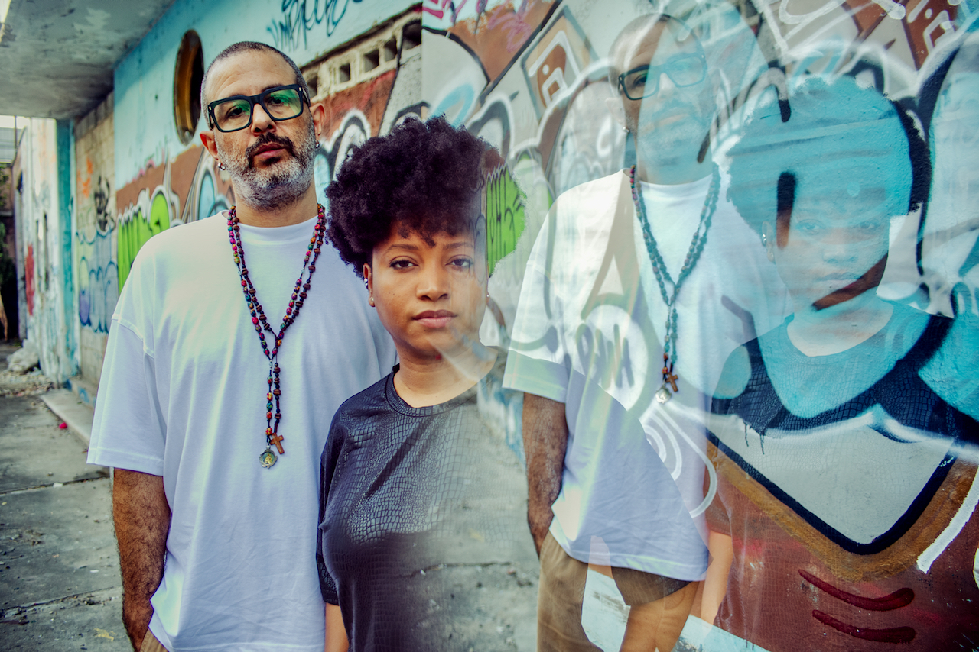
“República del Underground” Residencia Artística Multidisciplinaria
República del Underground is a dynamic platform dedicated to nurturing the Dominican Republic’s independent art scene. Through an interdisciplinary residency, the project gathers artists from music, street art, visual arts, crafts, and literature to collaborate, create, and document their process. Featuring podcasts, interviews, and live events, the residency highlights the voices and creative processes of artists deeply rooted in their communities. República del Underground aims to fuel cross-disciplinary innovation, expand the reach of independent art, and inspire a new generation of underground creators.
Mediumship Music RSL
Residency
Dominican Republic

Slide 9

Caribbean Collaboration
Projects that reflect or catalyze intra-regional cooperation and
the promotion of arts across linguistic and geographic boundaries within the region.
—
10 grantees receiving USD 25,000

Slide 10
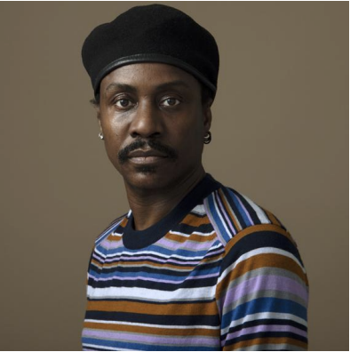
NEV en REV (Nègres en vente en Réalité virtuelle)
NEV en REV (Nègres en vente en Réalité virtuelle) is an experimental project tracing the memory of slavery on the island of Quisqueya (Haiti and the Dominican Republic) through a new immersive virtual reality experience. Building on Guy Régis Jr’s acclaimed sound and performance installation NEV, this new phase brings together Haitian and Dominican historians and artists to share archival material, testimonies, and spatial memories. The work honors the shared trauma and resistance across the island, reimagining the legacy of slavery in a cross-border creative process that blends technology, history, and embodied storytelling.
Guy Régis Jr
Multimedia
Haiti and Dominican Republic

Slide 11
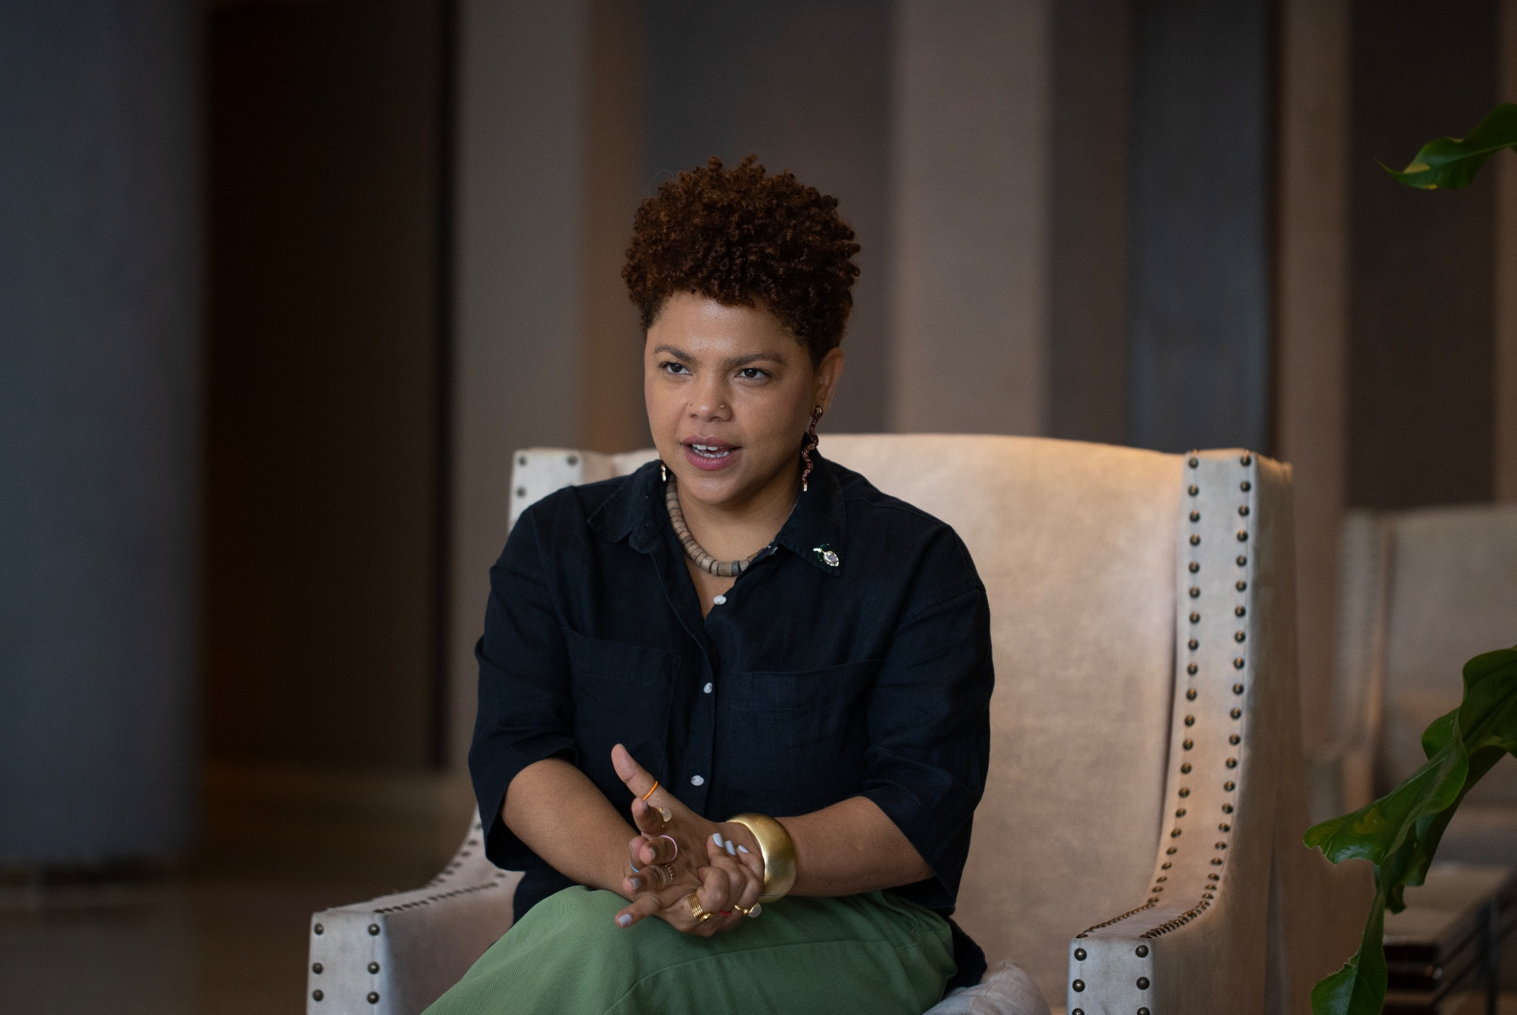
Sugar Island
The film Sugar Island explores the deep colonial roots of the Caribbean sugar industry and its legacy in contemporary society. This regional tour brings the film to historic sites and cultural institutions in Cuba, Puerto Rico, and the Dominican Republic, fostering critical dialogue through post-screening discussions, site visits, and decolonial storytelling. The screenings connect Caribbean audiences across borders, opening space to reflect on memory, resistance, and the shared histories of maritime and sugar-producing territories. The tour also lays groundwork for an alternative Caribbean cinema network grounded in community, memory, and cultural sovereignty.
Johanné Gómez Terrero
Film
Dominican Republic, Puerto Rico and Cuba

Slide 12
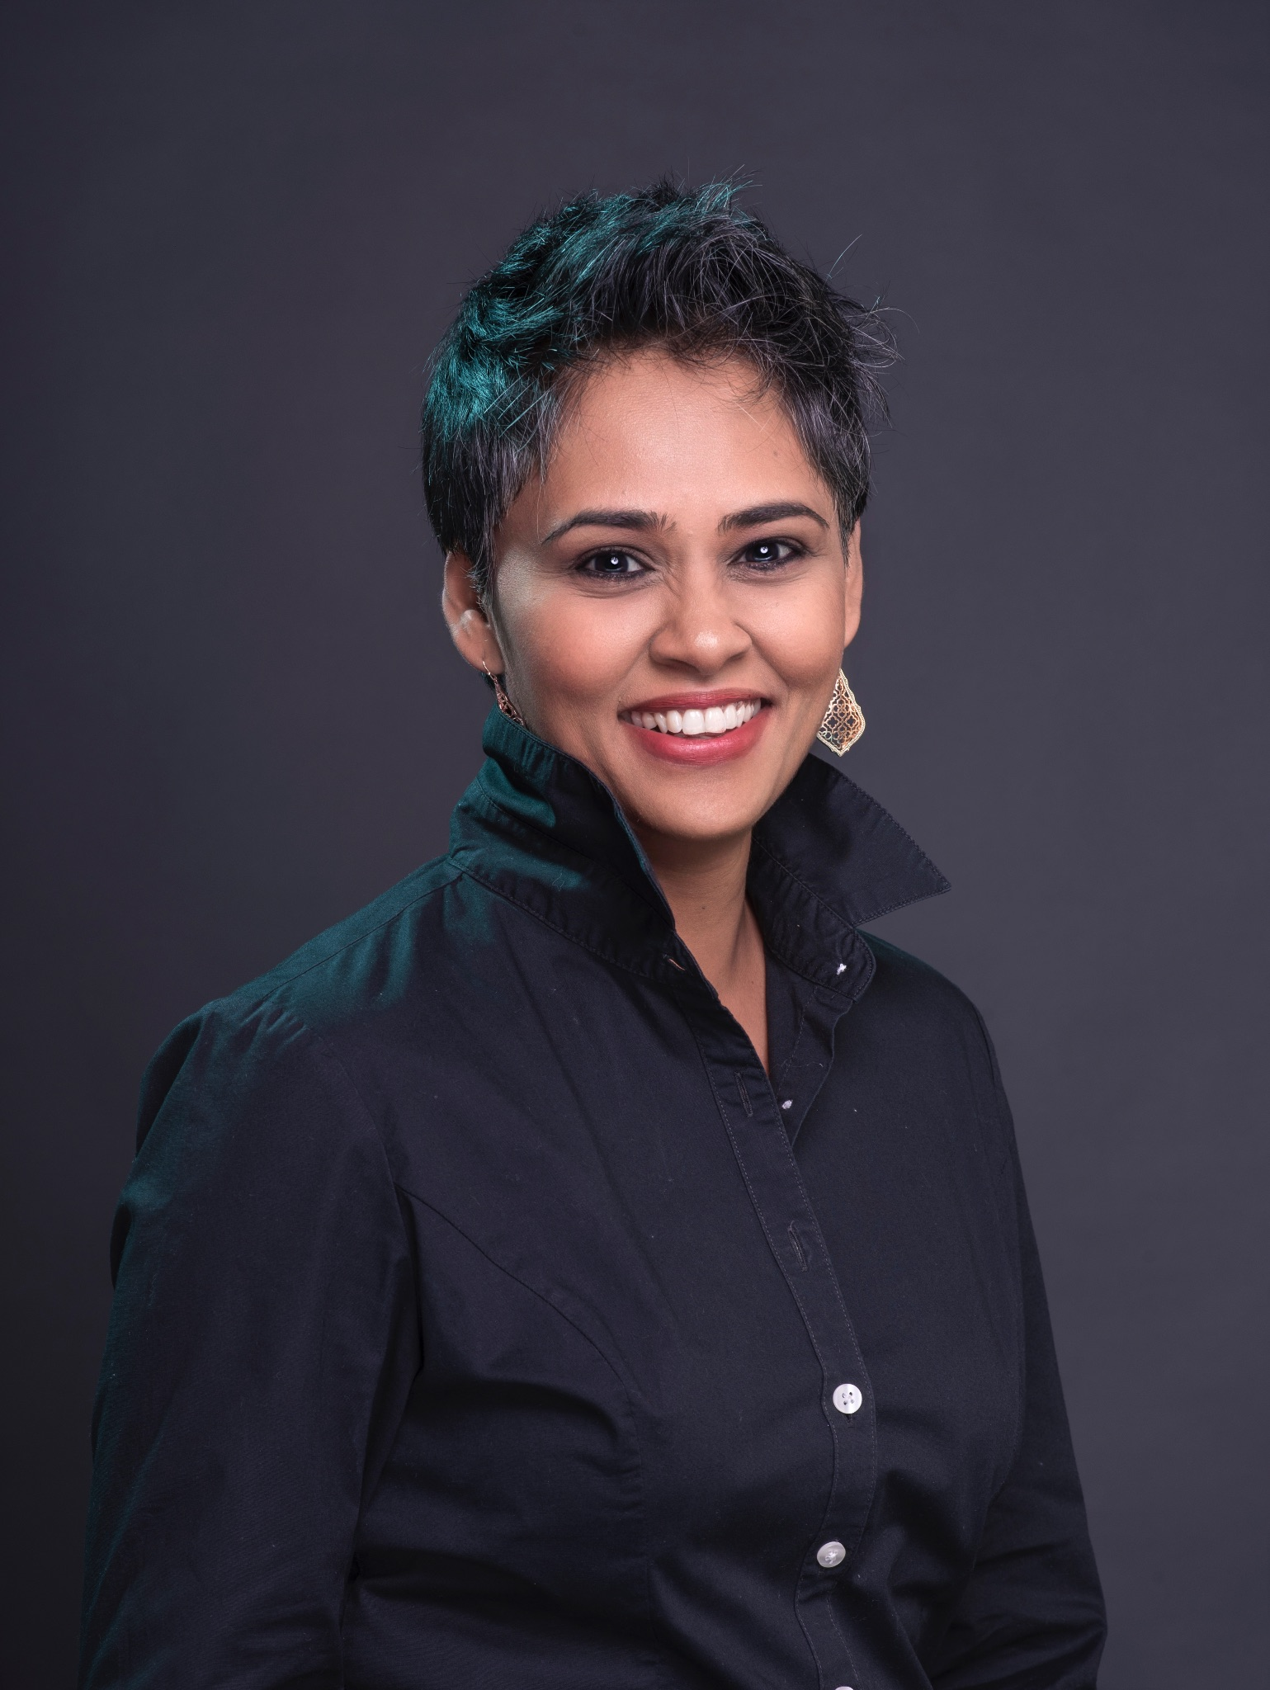
Soundscaping the Caribbean Ecosystem: Women and Music
This participatory sound project introduces young women (ages 16–18) in Jamaica and Trinidad and Tobago to environmental listening and musical composition using field recordings. Participants capture sounds from their everyday surroundings — from ocean waves to city noise — and craft original soundtracks, blending traditional music with their lived environments. The project fosters awareness of both ecological and cultural landscapes, while opening doors for women in music and sound production. The resulting archive becomes a living, evolving map of Caribbean soundscapes, promoting creativity, self-expression, and technical skill in underrepresented communities.
SharPa Notes Production Ltd
Music and sound recording
Trinidad and Tobago, Jamaica

Slide 13
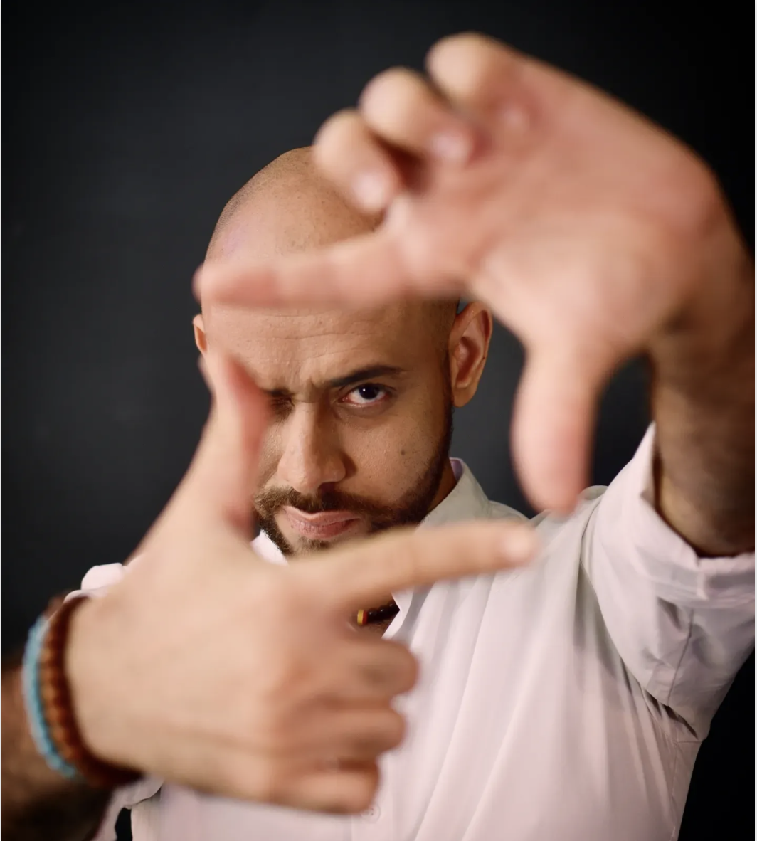
Residencia Artística El Cruce 2024
El Cruce is a Caribbean arts residency designed to foster creative exchange and critical dialogue across borders. Founded by Dominican artist and cultural worker Helen Ceballos, the 2025 edition features two week-long residencies — one in Santiago de Cuba and another at the Dominican-Haitian border — bringing together 20 artists from across the region. Focusing on process over product, the program includes workshops, artist talks, public presentations, and community-based actions. El Cruce strengthens artistic networks and seeds long-term impact in participants’ home communities, as seen in the creation of La Pluma, the Dominican Republic’s first LGBTQIAP+ theatre festival, inspired by the 2023 edition.
Tomas Perez
Performing arts
Dominican Republic

Slide 14
Congratulations to our grantees.
For more information on the grantees, please email
info@caribbeanculturefund.org
or grants@caribbeanculturefund.org

